Slide 1
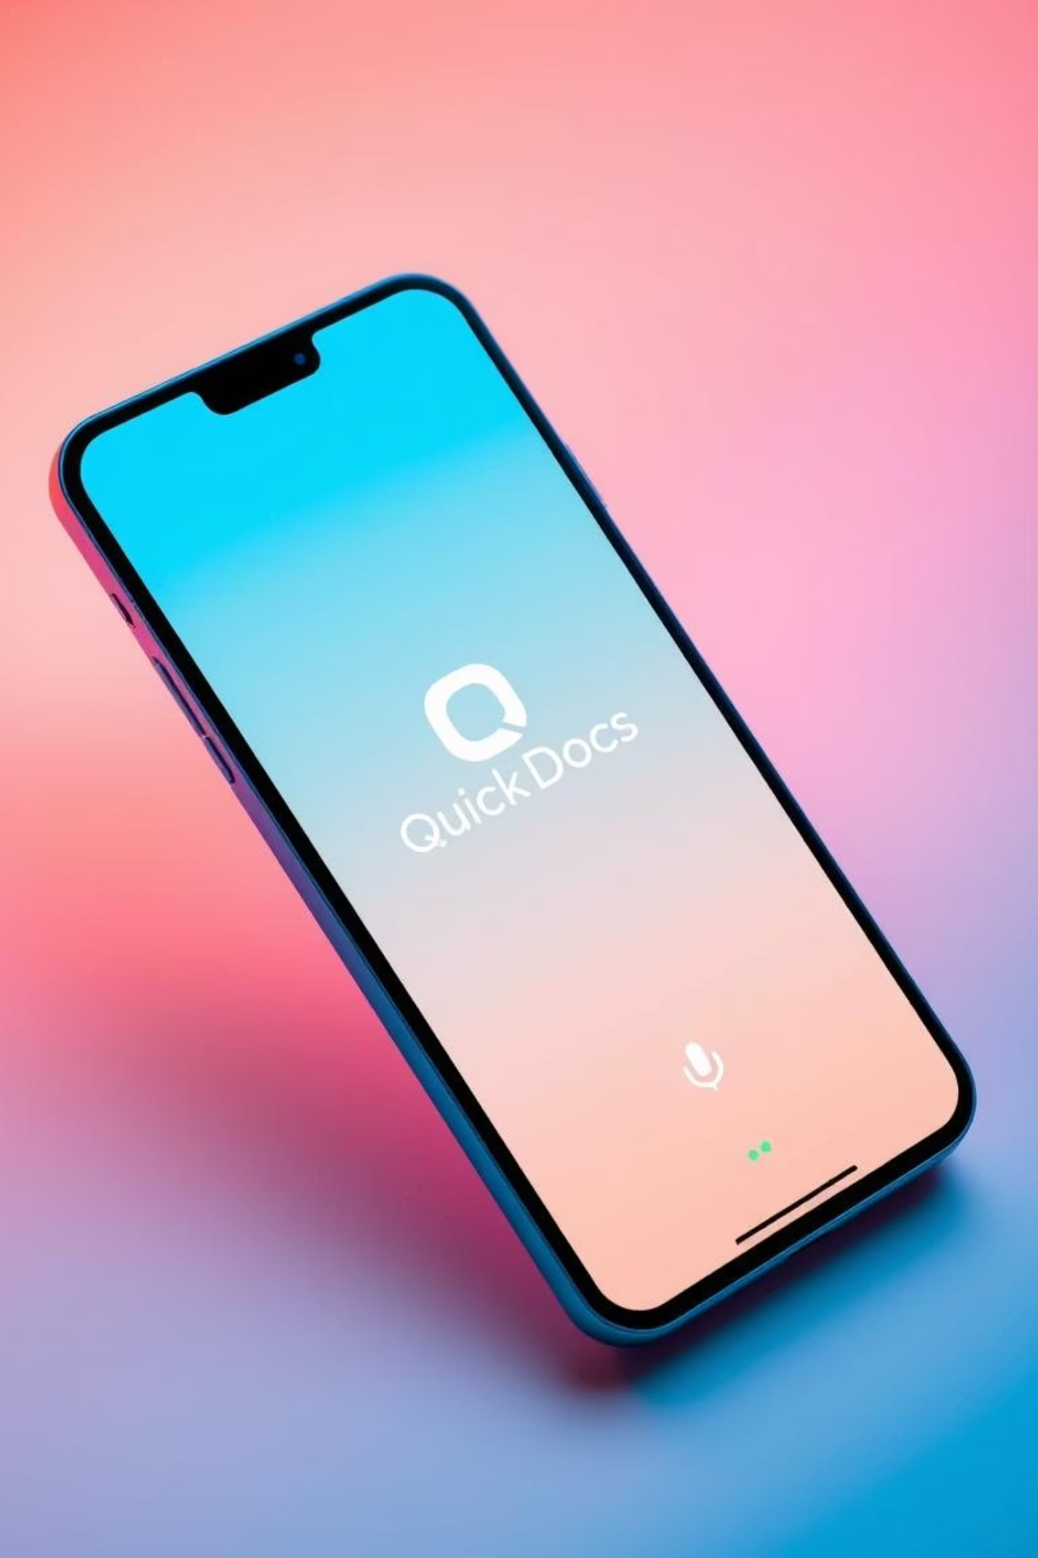
QuickDocs
Managing documents on mobile is often manual, time-consuming, and lacks intelligence.Users face challenges like finding information quickly, language barriers, and limited voice-based support.

Slide 2


The Document Challenge: Why QuickDocs?
Students
Students waste time manually searching documents and lack tools to quickly extract key academic or personal info.
Common people
Common users struggle to find important details in documents and face language barriers with complex apps.
Business Professionals
Busy professionals deal with scattered files and inefficient mobile document access.

Slide 3





QuickDocs Solution: Intelligent & Accessible
QuickDocs addresses these challenges by offering a comprehensive, AI-powered solution for all your document needs.
Effortless Management
Seamlessly upload and organize documents, ensuring everything is in its right place.
AI-Powered Insights (RAG)
Get instant answers and summaries from your documents using advanced AI Retrieval-Augmented Generation.
Voice-First & Multilingual
Interact with your documents hands-free in multiple languages (English, Telugu, Hindi).
Secure & Scalable
Robust backend infrastructure ensures your data is always safe and accessible.

Slide 4
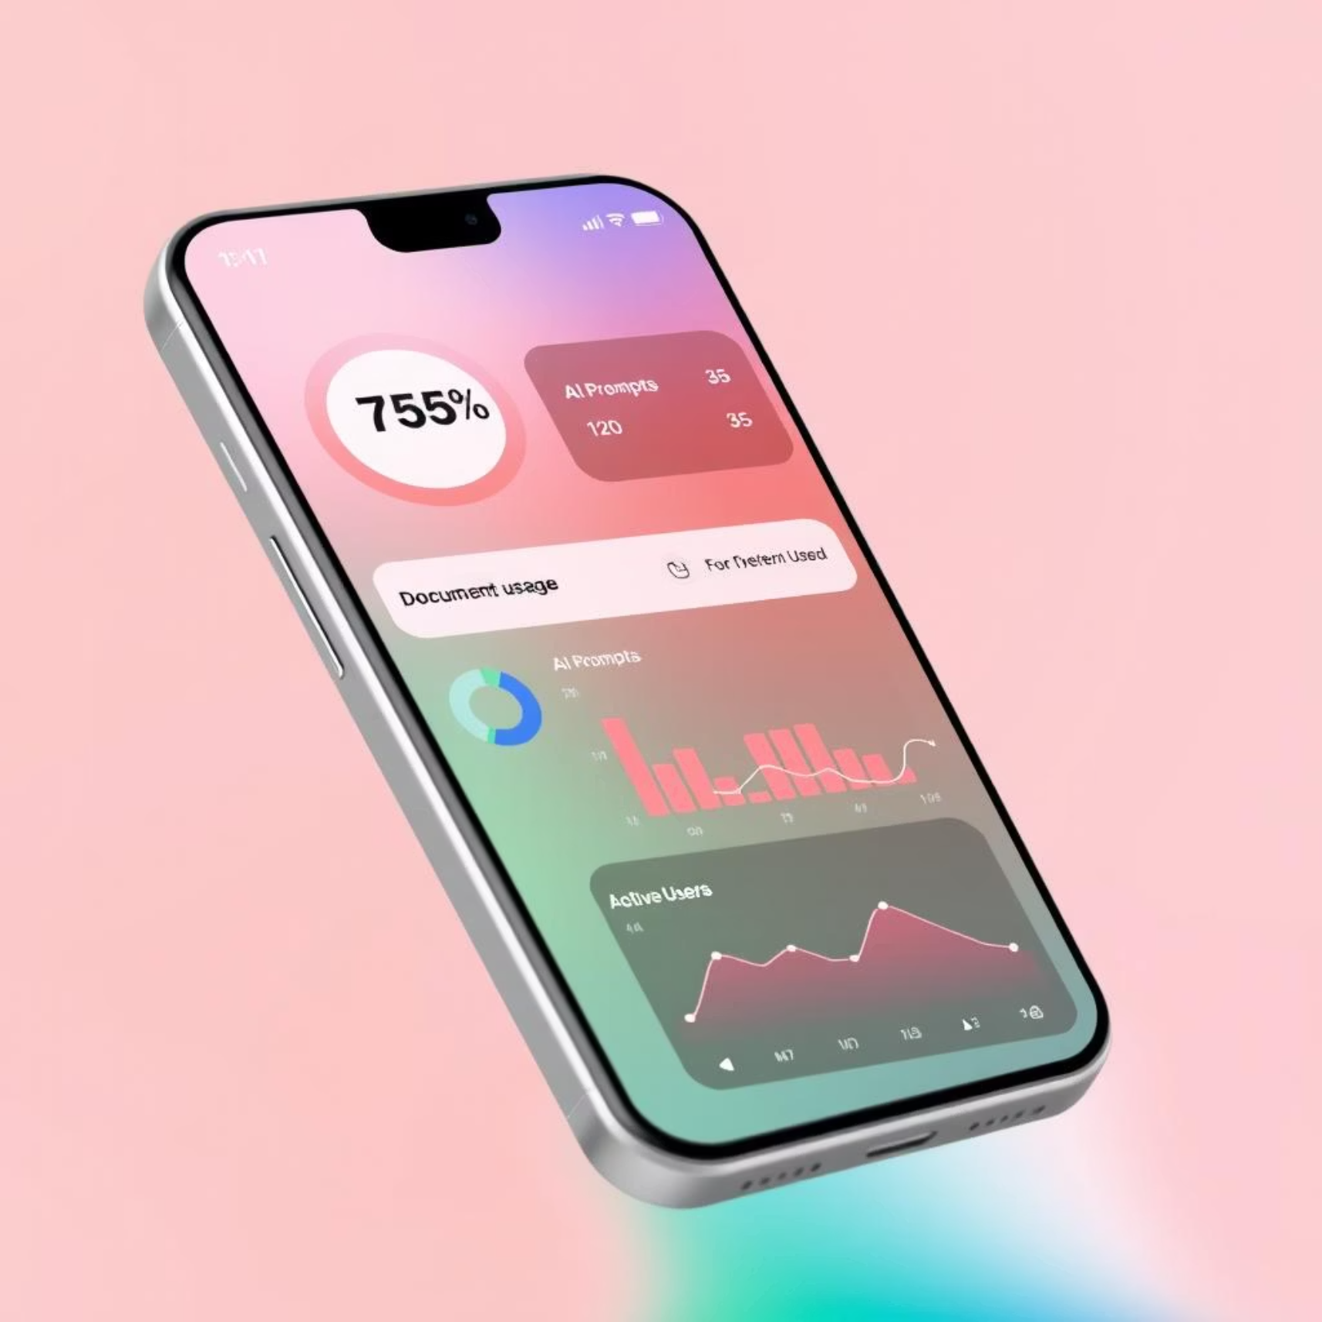
Core Features:
Document Upload & Viewing
Supports various formats including images and PDFs for easy management.
Voice-to-Voice AI Assistant
Engage naturally with AI in English and Telugu for seamless interaction.
Secure Authentication
Login with PIN and biometric options for enhanced data protection.
Smart Q&A with RAG
Leverage AI to get precise, context-aware answers directly from your documents.
Real-time Usage Dashboard
Monitor your AI interactions and Queries with comprehensive analytics.

Slide 5
Robust Technology Stack
QuickDocs is built on a modern, secure, and scalable technology architecture to ensure peak performance and reliability.
Frontend
Backend
React Native (Expo)
Node.js + Express
Database
AI Engine
MongoDB + Vector Search
Custom LLM (Trains on User-Specific Data)
Cloud Platform
Security
Google Cloud Platform
JWT, AES, Bcrypt

Slide 6
Intelligent AI Capabilities
Harnessing the power of advanced AI, QuickDocs provides a truly intelligent document experience.
Retrieval-Augmented Generation (RAG)
AI retrieves relevant information from your documents to generate accurate, informed responses.
OCR + Vector Search
Optical Character Recognition extracts text, which is then indexed with vector search for lightning-fast retrieval.
Language Detection & Translation
Automatically identifies languages and translates conversations for seamless multilingual support.
Multi-modal Interaction
Interact using voice, text, or directly through your documents, offering unparalleled flexibility.
LLM Integration
Leverages cutting-edge AI model for highly contextual and relavant responses.

Slide 7





Secure by Design
Your privacy and data security are paramount. QuickDocs employs multiple layers of protection.
JWT & Bcrypt
Secure token-based authentication and robust password hashing.
Biometric & PIN
Convenient and strong multi-factor authentication methods.
AES Encryption
Advanced Encryption Standard for all sensitive data at rest and in transit.
Secure APIs & Storage
HTTPS for all API calls and secure storage solutions like Expo Secure Store.

Slide 8
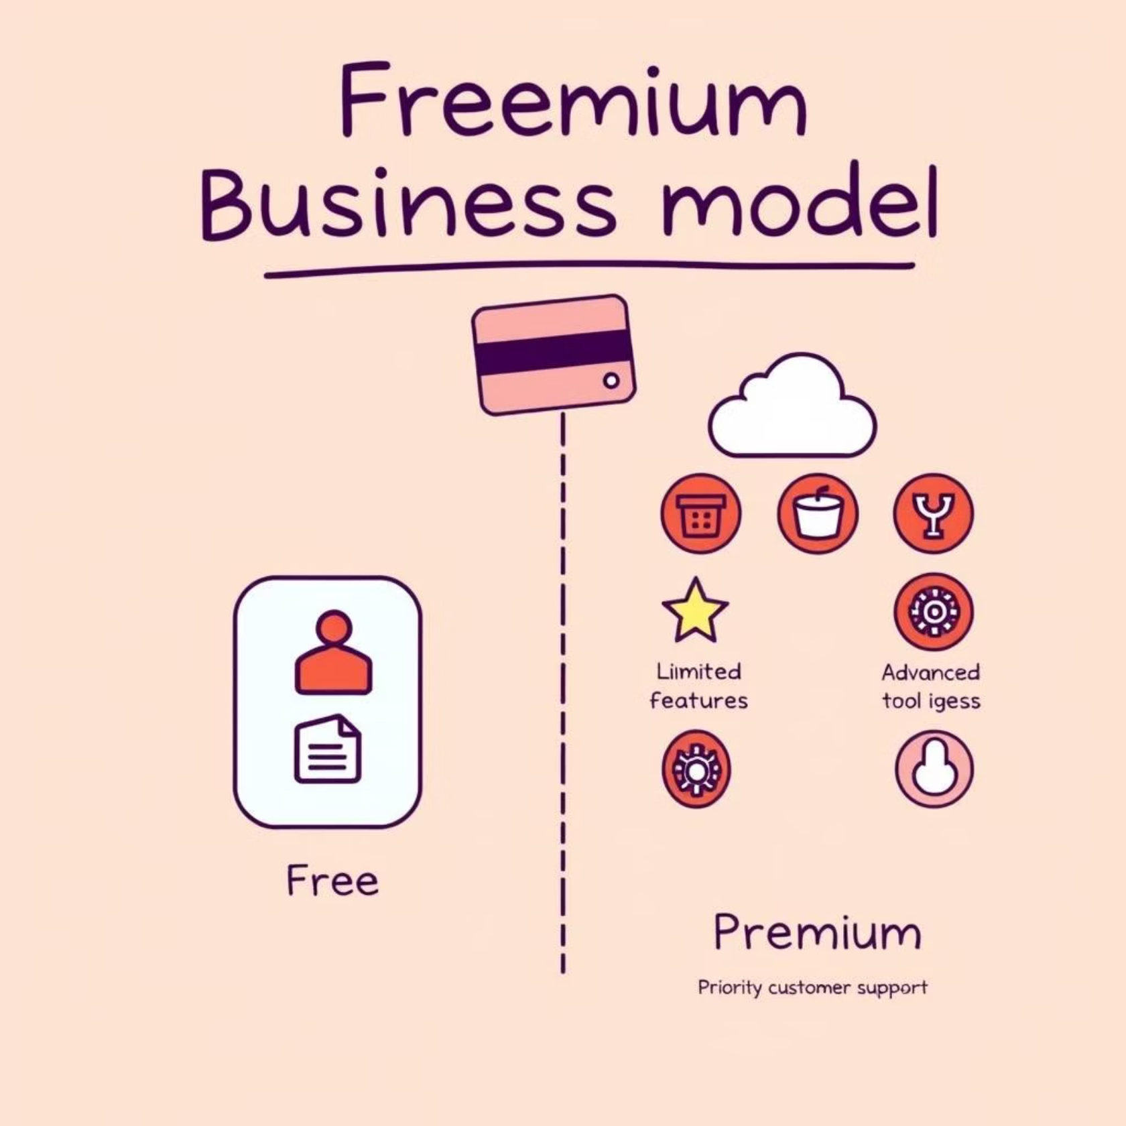
Business Model & Future Vision
Premium Model
Access basic features for free, with premium subscriptions unlocking unlimited capabilities via Razorpay.
Expanding Market Potential
Targeting students, professionals, and small teams with a growing demand for smart document tools.
Future Roadmap
Planned enhancements include a web version, team collaboration, blockchain verification, and enterprise APIs.

